Slide 1


GLOBAL HEALTH INDICATOR
Analyzing Socioeconomic,Environmental,and Health Trends Across Countries
Varsha Patil USN:2GI22EC180
Yash Sadalge usn:2GI22EC189

Slide 2
INTRODUCTION
PROBLEM STATEMENT
AIM
OBJECTIVE
LITERATURE SURVEY
METHODOLOGY
REFERENCES

Slide 3
INTRODUCTION:
Dataset comprises the overall health and socioeconomic indicators across a variety of years for a number of countries. The scope of the metrics encompasses a wide range of statistics, from fertility rate and urbanization to life expectancy and unemployment rates, access to clean water, expenditure on healthcare, immunization levels, and exposure to air pollution.

Slide 4

AIM :
Understand the disparity between countries, and understand how
different indicators relate to each other. It seeks to give insights that
are actionable to researchers, policymakers,
and organizations seeking to improve health outcomes across the globe and attain the SDGs.. The specific objectives are:

Slide 5
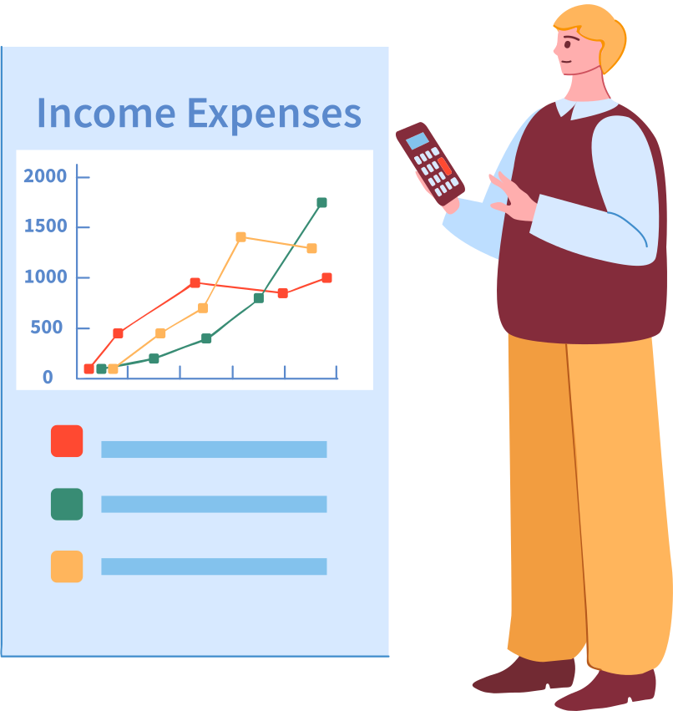
OBJECTIVES:
·- Descriptive Analysis
·- Regional Disparities.
·- Predictive analysis and visualisation.
·Socioeconomic Development Analysis

Slide 6
LITERATURE SURVEY
REF NO | TITLE OF THE PAPER | AUTHOR | PUBLISHED YEAR | FEATURES
1 | Global Health: Science and Practice Journal | Emily Blynn, Emily Harris, Melanie Wendland, Courtney Chang | November 2021, | Worked on countries mobility,fertility
2 | Global burden of 87 risk factors in 204 countries and territories, 1990–2019: a systematic analysis for the Global Burden of Disease Study 2019 | Shilpa das ,nikki tylaor | October 17, 2020 | Comparison between countries and carbon dioxide concentration

Slide 7
Input Dataset (CSV)
Global Health Indicators
Years, Countries, GDP
Life Expectancy, Health Exp
Block daigram
Remove Missing Values
Handle Duplicates
Normalize and Clean Data
Data Analysis
Descriptive Statistics
Correlation Analysis
Trend Analysis (Time Series)
Data Visualization
Bar Charts
Scatter Plots
Heatmaps
Line Graphs/Trends

Slide 8
METHOD:
Data cleaning or preprocessing
Exploratory Data Analysis (EDA)
Trend Identification
Correlation Analysis
.Regional and Country Comparisons
Clustering analysis

